Slide 1
Contact Center Data Analysis - Tableau Dashboard

Slide 2
How can a healthcare organization ensure timely access to support, maintain service quality, and proactively identify operational issues in its contact center?
About Dataset
The dataset represents healthcare contact center operations, capturing call-level interactions related to claims, enrollment, benefits, prior authorization, billing, and system access.
It includes operational, quality, and performance metrics such as wait time, handle time, SLA targets, call outcomes, first call resolution, escalation, and abandonment.
The data spans multiple months, enabling trend analysis, peak-hour identification, and operational planning.
Calls are segmented by queue, call reason, member type, and channel, allowing targeted analysis across different business functions.
The dataset is designed to mirror real-world healthcare contact center systems while remaining HIPAA-safe and non-identifiable.

Slide 3
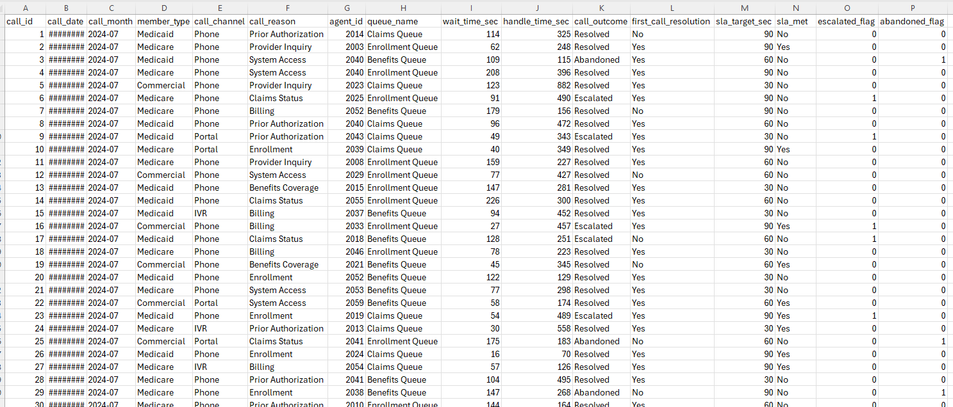
Data Set
SELECT *
FROM contact_center_ops
LIMIT 50;
import pandas as pd
df = pd.read_csv("contact_center_ops_enhanced.csv")

Slide 4
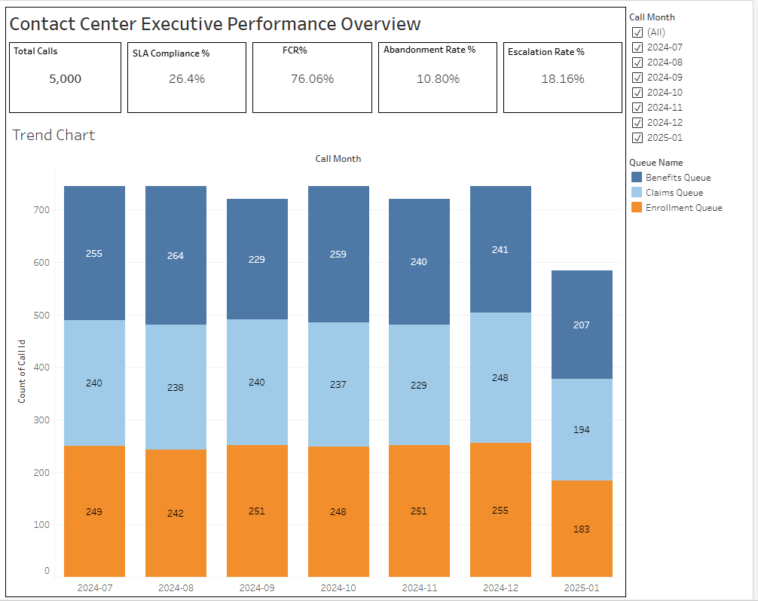

Slide 5
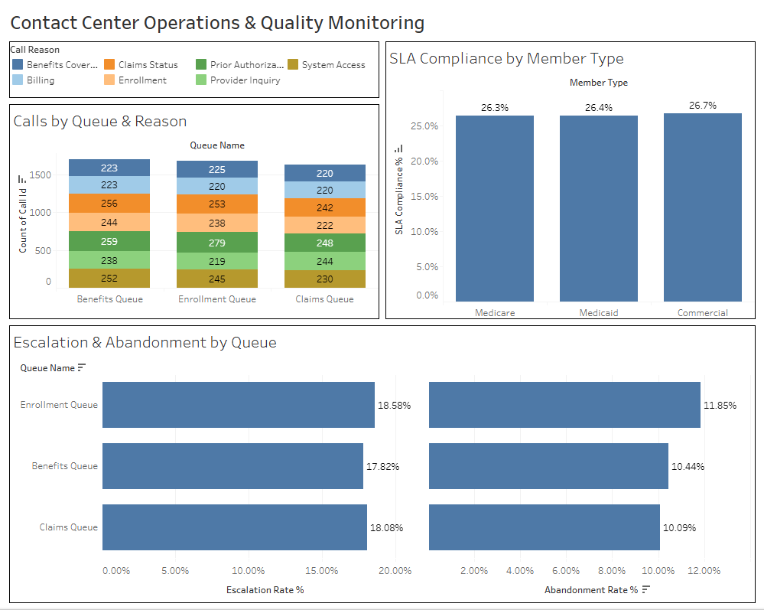

Slide 6
Link to Dashboard
https://public.tableau.com/views/ContactCenterPerformance_17688507181890/Dashboard1?:language=en-US&:sid=&:redirect=auth&:display_count=n&:origin=viz_share_link
Data Dictionary
Average time a member waits before their call is answered. This is a core access-to-care KPI.
Average Speed of Answer (ASA) = AVG([wait_time_sec])
SLA Met Flag = IF [wait_time_sec] <= [sla_target_sec] THEN 1 ELSE 0 END
SLA Compliance % = AVG([SLA Met Flag])
This measures the percentage of calls answered within the defined SLA threshold, which directly reflects service quality and operational performance.
First Call Resolution (FCR %)
FCR measures how effectively member issues are resolved on the first contact, which is a key quality and efficiency indicator.

Slide 7
FCR Flag= IF [first_call_resolution] = "Yes" THEN 1 ELSE 0 END
FCR %= AVG([FCR Flag])
Abandonment Flag = IF [call_outcome] = "Abandoned" THEN 1 ELSE 0 END
Abandonment Rate % = AVG([Abandonment Flag])
Abandonment Rate is the percentage of calls where members hang up before their call is answered by an agent.
Escalation Rate % = AVG([escalated_flag])
Escalation Rate measures the percentage of calls that could not be resolved by the first-level agent and required additional support.

Slide 8
Point of Contact
Data Engineering Team – xyz@gmail.com
Business Team – abc@gmail.com
Prod support/issues – cde@gmail.com
BI Team – hello@gmail.com
Testing Team – test@gmail.com
Users – user1@gmail.com, user2@gmail.com

